Slide 1

JavaScript
by Alex Joslin

Slide 2
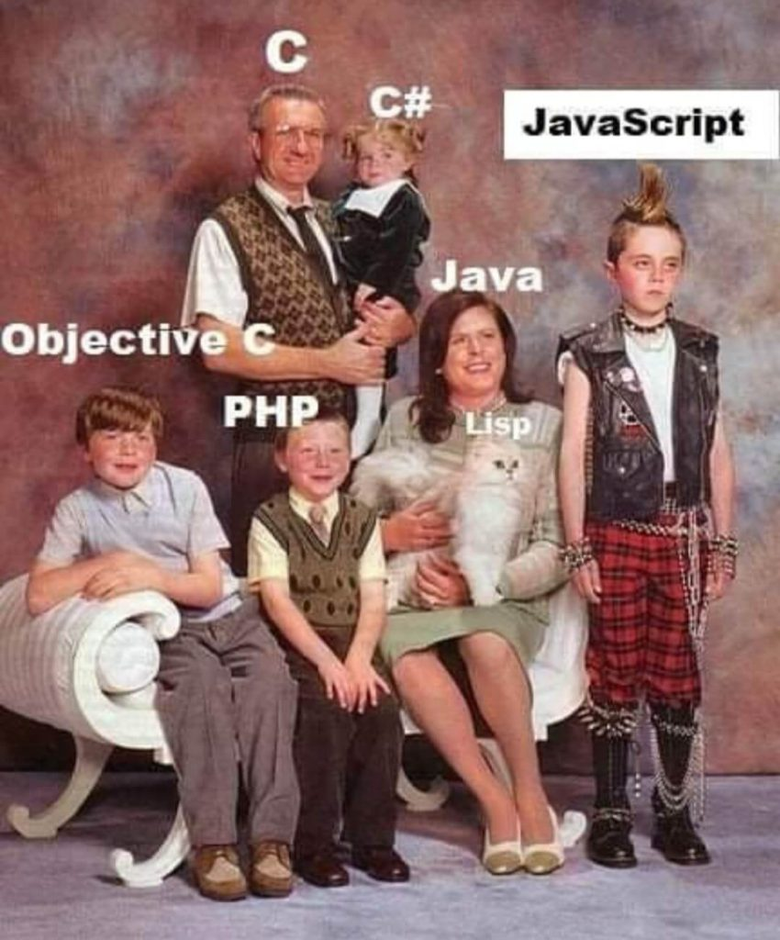
Part 1 The History of JavaScript

Slide 3

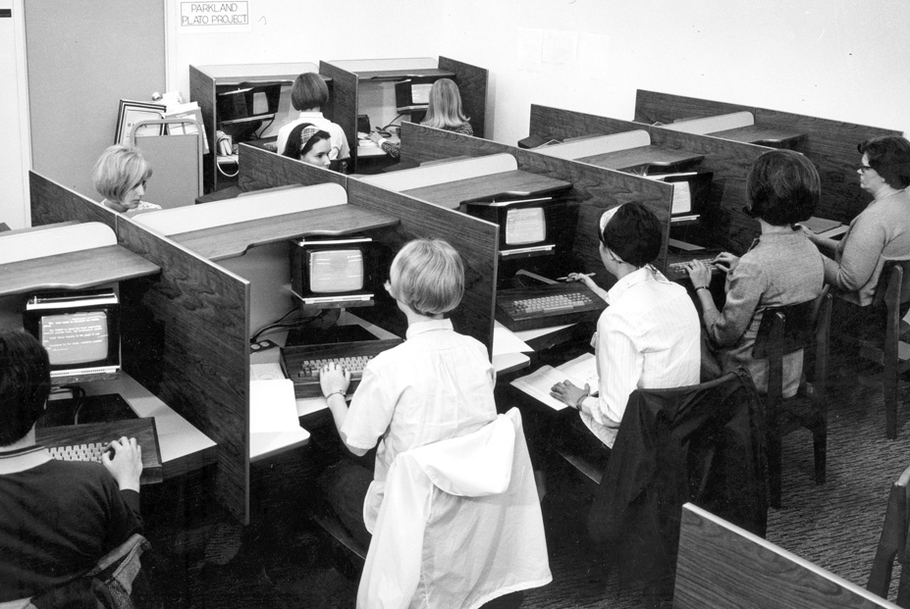
January 1st 1983

Slide 4
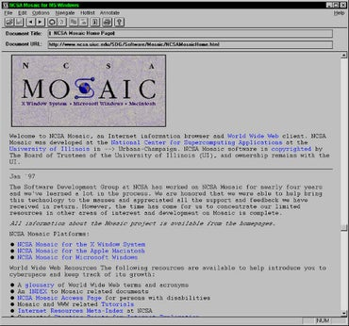
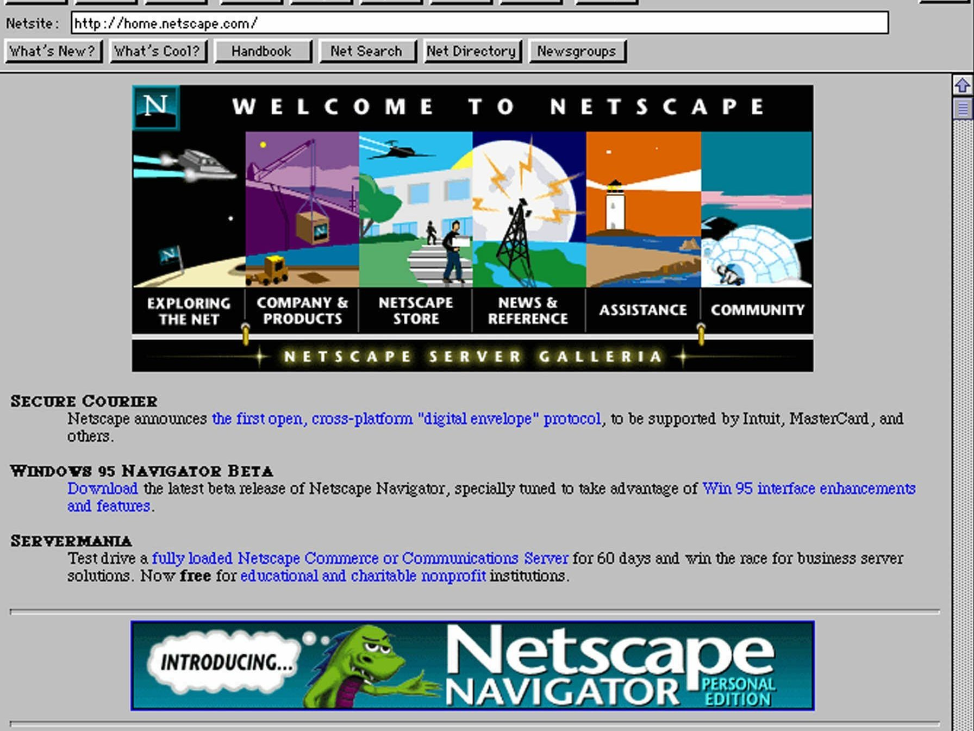
How the internet looked like

Slide 5

JavaScript - 1995
JavaScript was invented in 1995
by Brendan Eich
It was actually called “Mocha” back then. Later on they renamed it LiveScript. Then renamed it again to JavaScript.
JS made pages more interactive

Slide 6
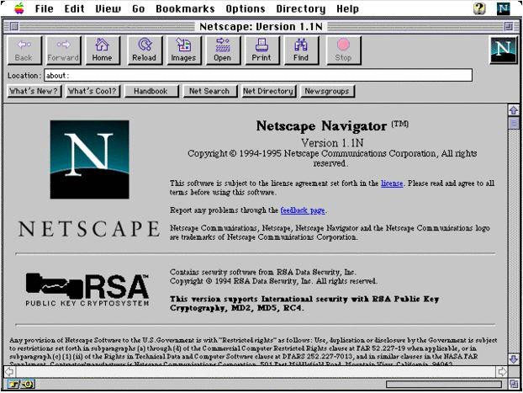


JavaScript
JScript

Slide 7

European Computer Manufacturers Association
An Organization for settings standards.
In 1997 they came out with their first spec or set of guidelines for implementing the JavaScript language. This was called ECMAScript.
Document was about 100 pages long.

Slide 8
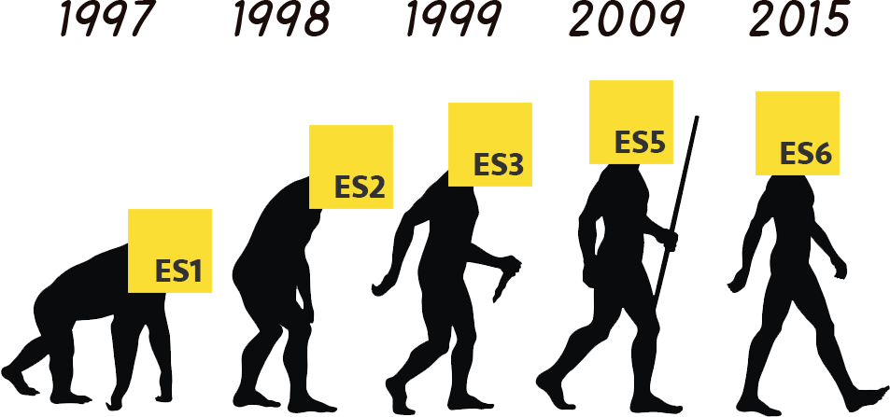
New ES6 Features: http://es6-features.org/#Constants

Slide 9

So what can you do with JavaScript?

Slide 10
A lot of things!
Frontend development
Backend development
Animations
Database Interactions
Server side programming
APIs
Websites, Web apps
Mobile Apps
Games
Block Chain Applications
Data Visualizations with D3
Create advanced algorithms

Slide 11
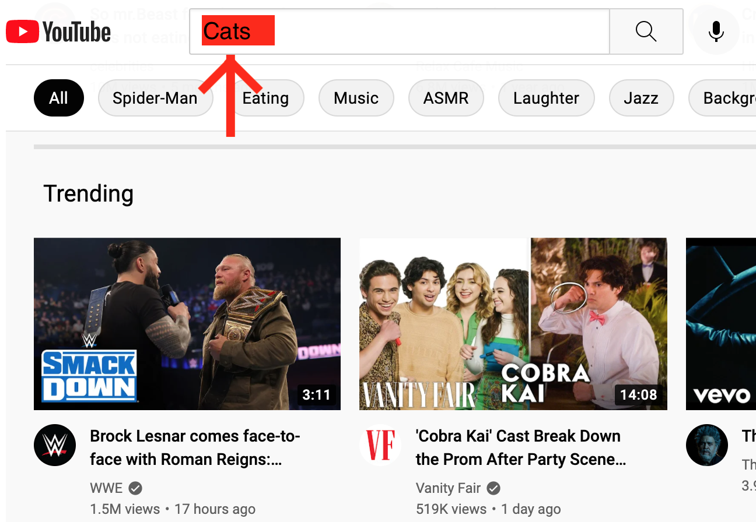
Frontend
Backend

Slide 12

Frontend
Backend
Request

Slide 13

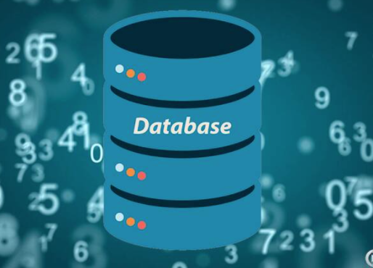
Frontend
Backend
Request

Slide 14
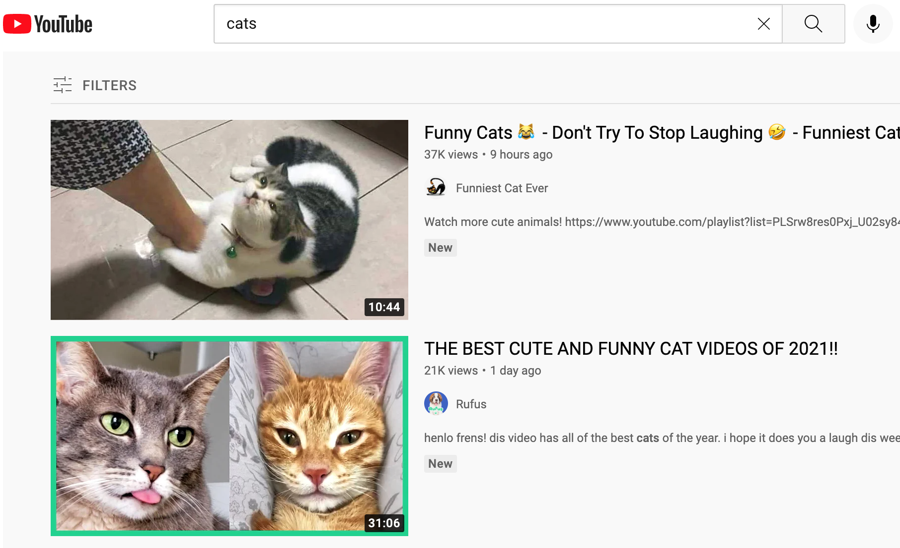
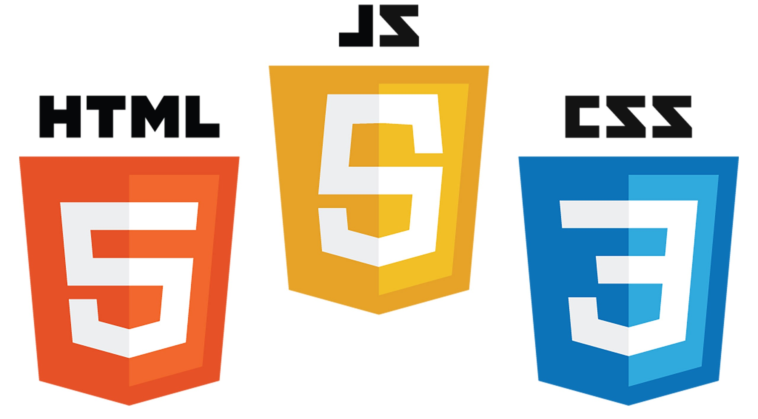
Frontend
Backend
Request
Response

Slide 15
Cool Examples
Africa Map: https://codepen.io/ktich/pen/ExVmYGr
Airplane: https://codepen.io/ste-vg/pen/GRooLza
My Maze Solver App: https://maze-solver-js.herokuapp.com/

Slide 16

Part 2 The History of Node.js

Slide 17
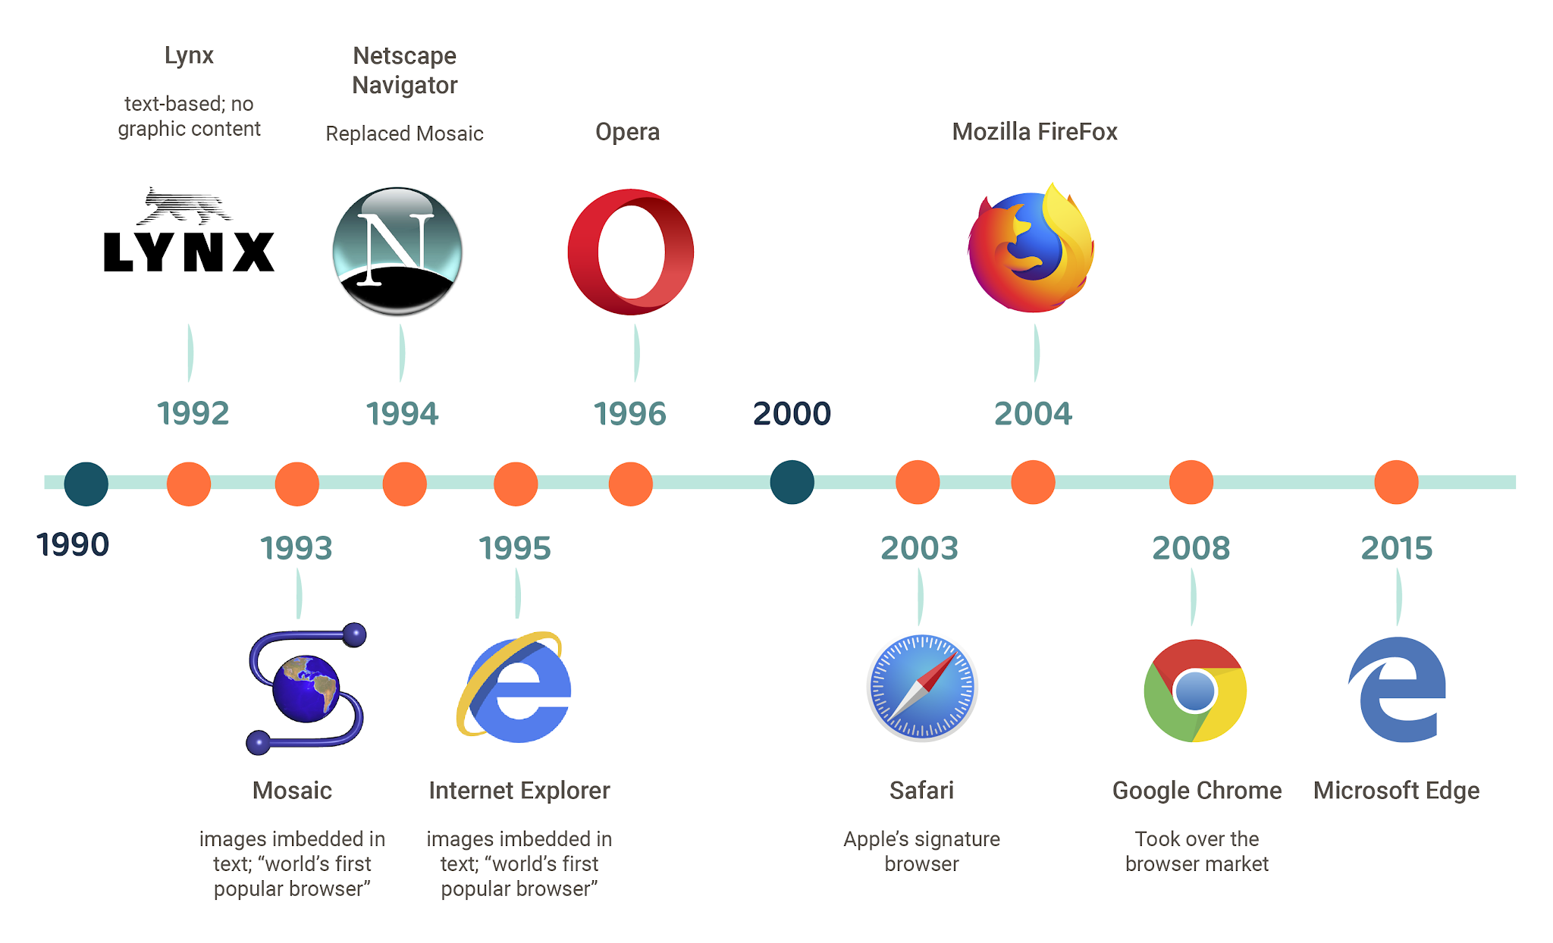
Browsers
https://youtu.be/W4wWdmfOibY?t=95

Slide 18


Chrome in 2018 & the V8 Engine
Chrome’s V8 engine revolutionized the way JavaScript is interpreted and compiled making it a viable option for high performance apps both on the browser and server side.

Slide 19
Frontend
Backend
Request
Response

Slide 20
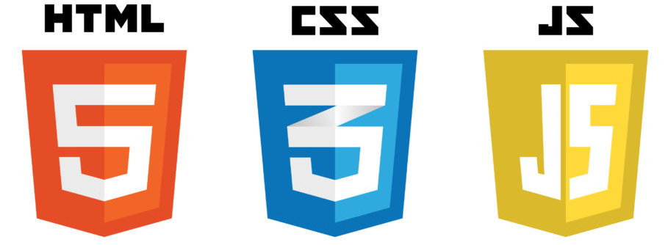
Frontend
Backend
Request
Response

Slide 21



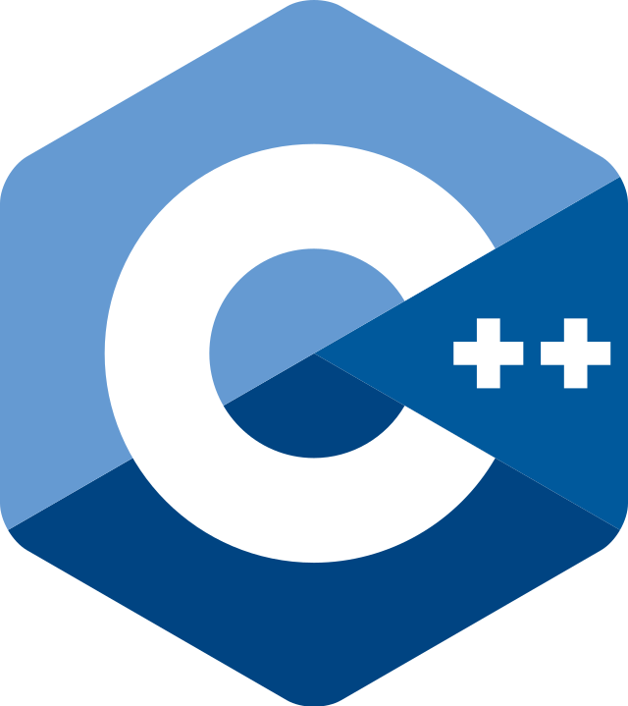

Frontend
Backend
Request
Response

Slide 22

Frontend
Backend
May 27, 2009
Request
Ryan Dahl
Response

Slide 23

Frontend
Backend
May 27, 2009
Request
Ryan Dahl
Response

Slide 24
Frontend
Backend
Request
Response

Slide 25

Frontend
Backend
Request
Response

Slide 26
Node.js
Node.js is not a programming language.
It is a runtime!
However, even though node implements their JavaScript according to ES6 node has its own way of importing modules but there is away to configure node to import the ES6 way.
Node.js comes with a package manager called npm to download libraries and frameworks.

Slide 27
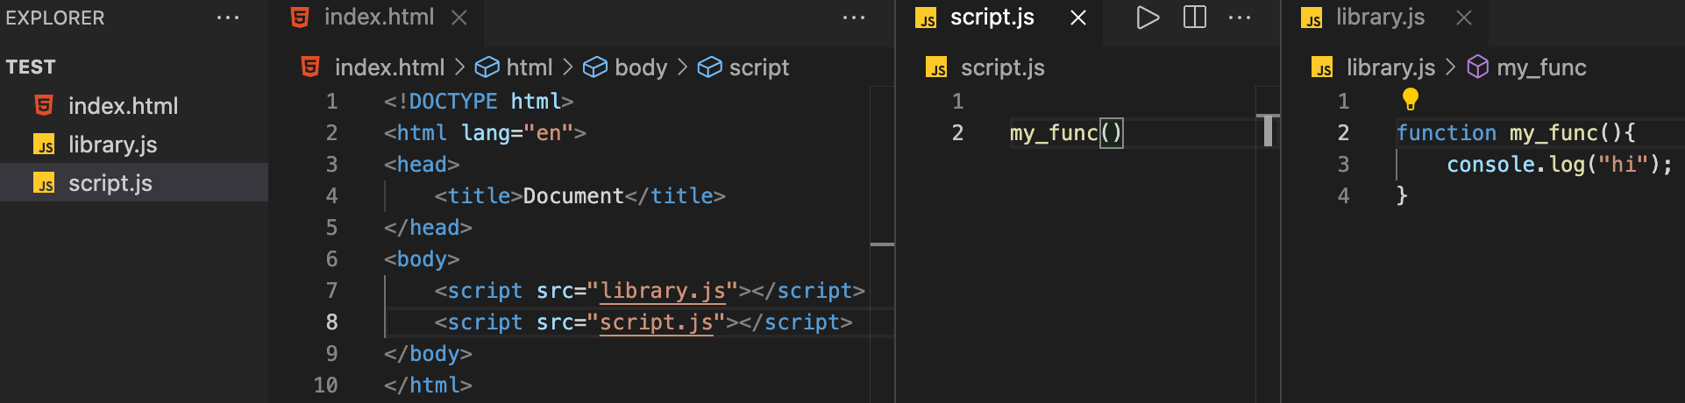
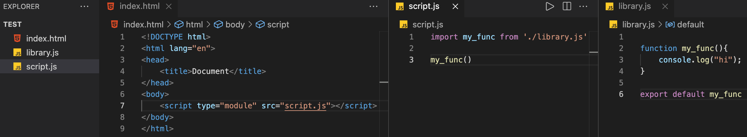
Weird thing about JavaScript: Importing
JavaScript
JavaScript + ES6 Modules

Slide 28
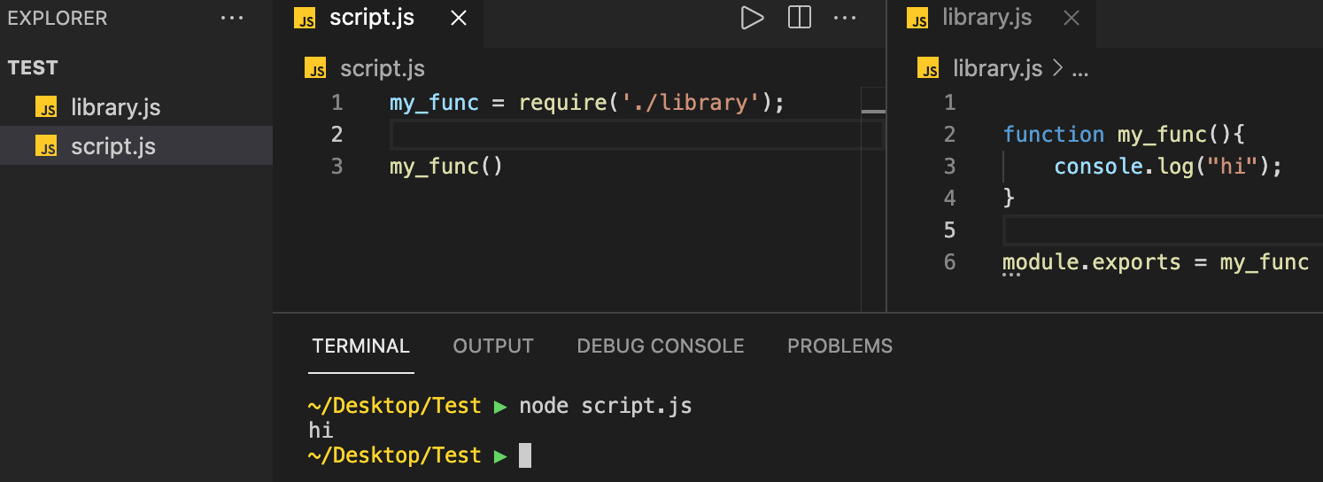
Weird thing about JavaScript: Importing –Node.js
Node.js

Slide 29

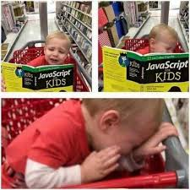

Slide 30

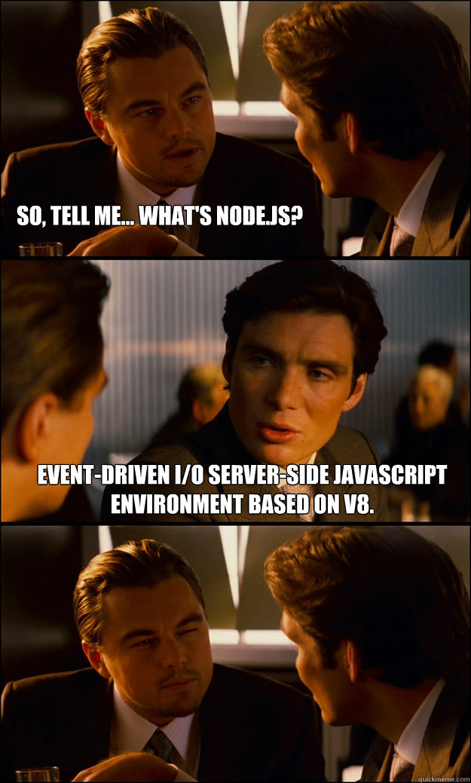

Slide 31
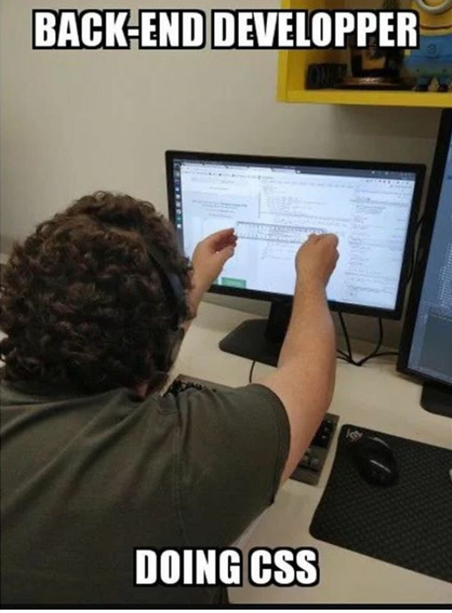


Slide 32
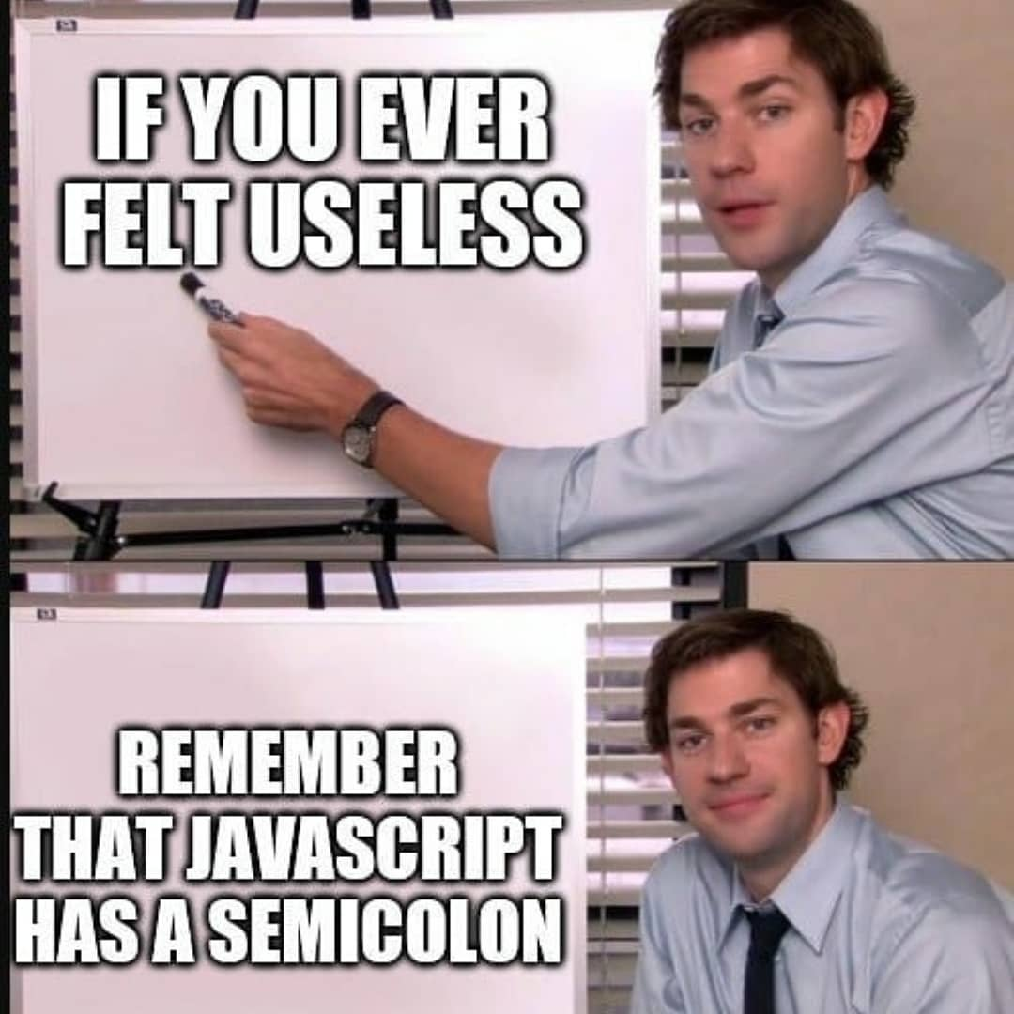
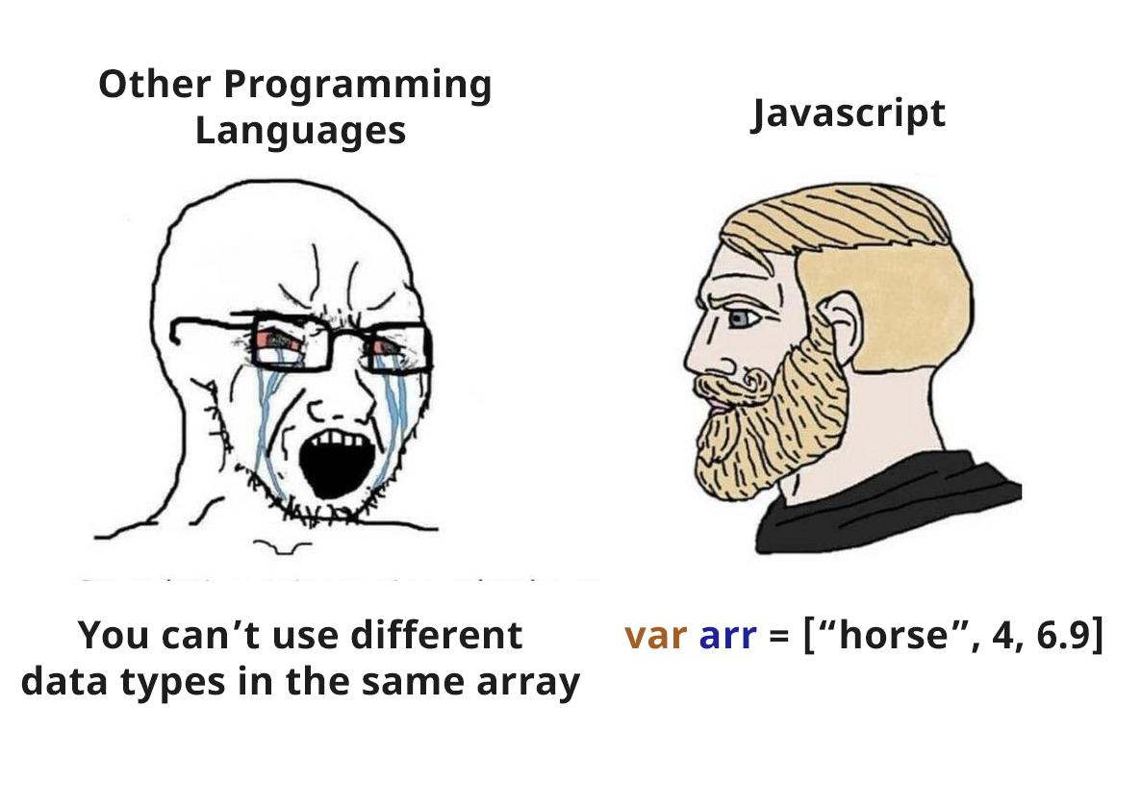

Slide 33
